Slide 1
MEDM
Kenneth Evans, Jr.
August 23, 2004

Slide 2
MEDM Overview
MEDM stands for Motif Editor and Display Manager
It is a graphical user interface (GUI) for designing and implementing control screens, also called displays
It is a mature program
  Robust
  Powerful
  Efficient
Tens of thousands of screens have been designed for MEDM
It is used worldwide at many sites
It is the primary means by which operators and engineers control the APS and its subsystems
  And most of the experiments

Slide 3
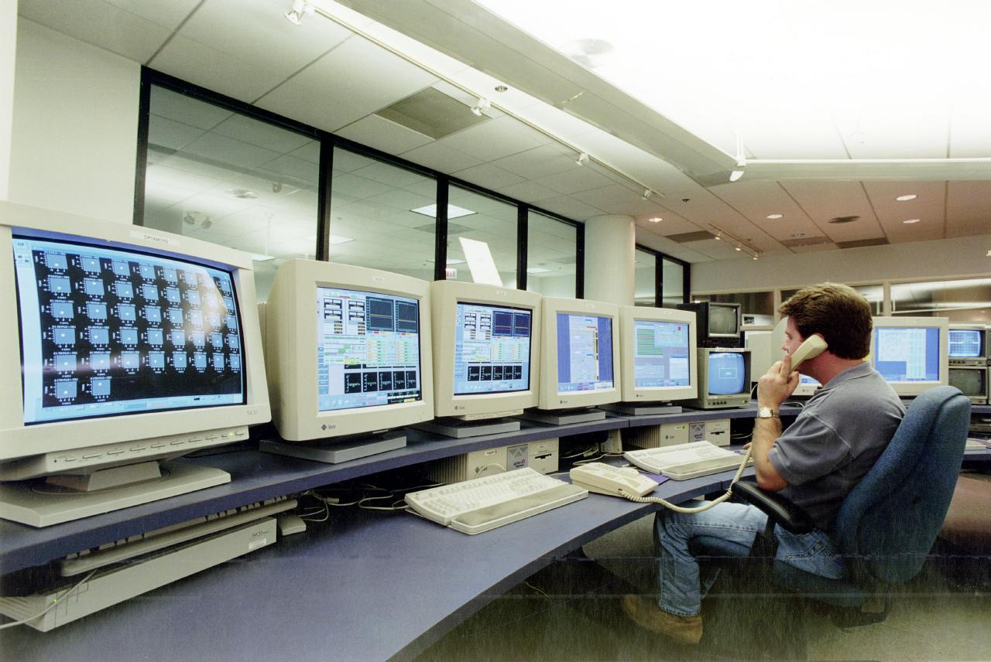
It is what you see in the Control Room

Slide 4
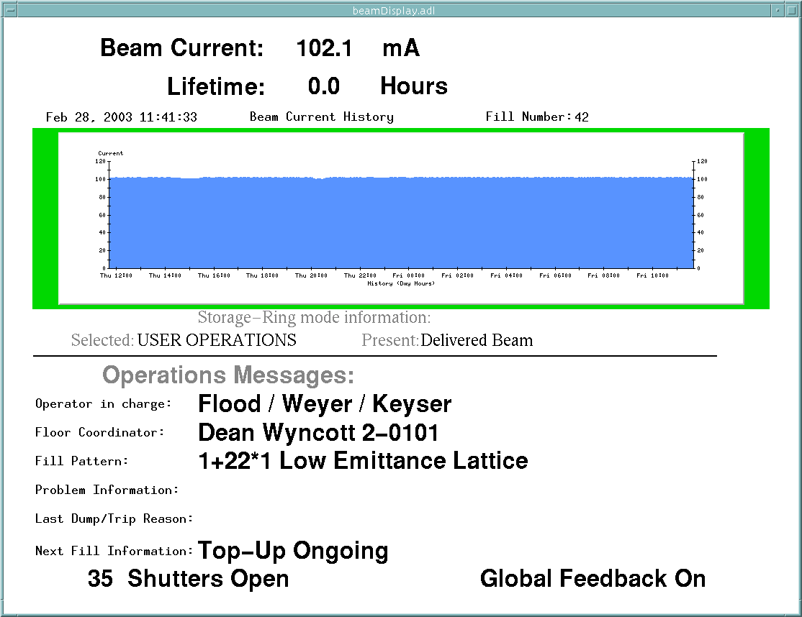
… or on the TV monitors

Slide 5
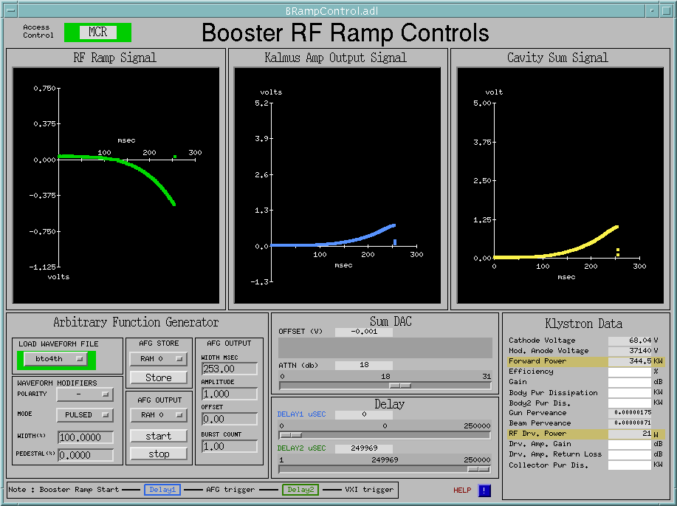
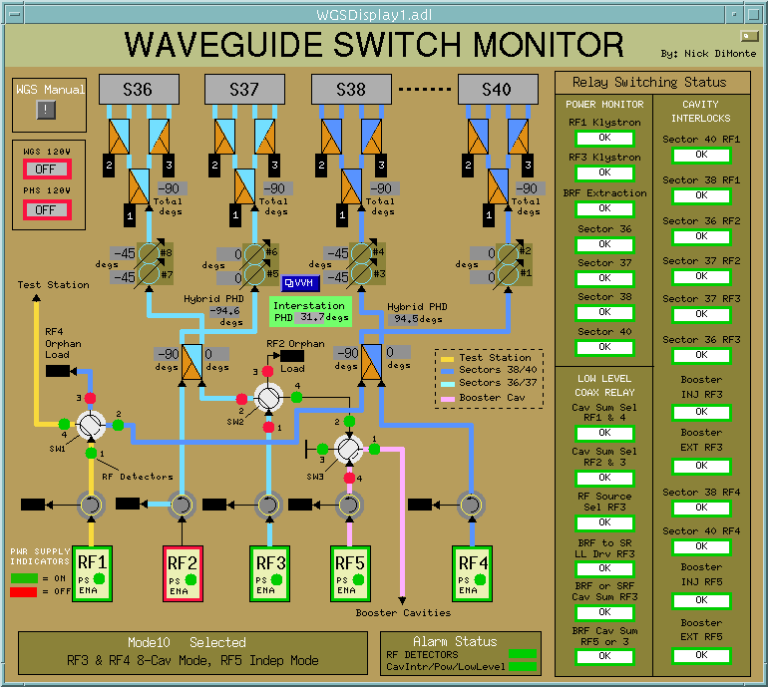
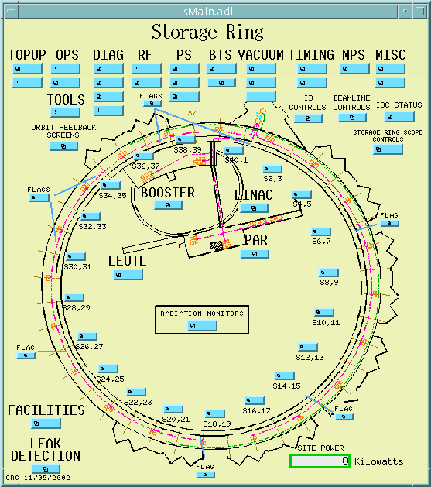
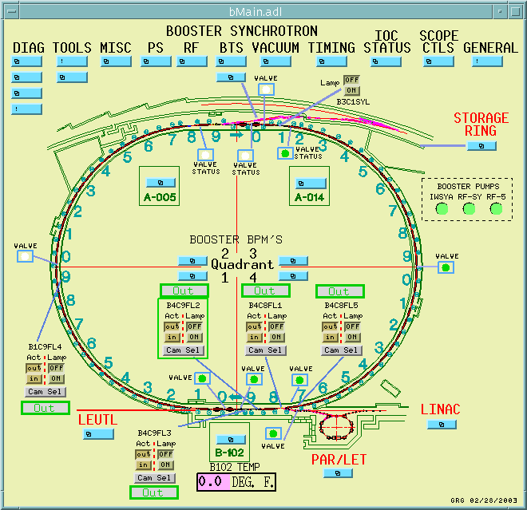
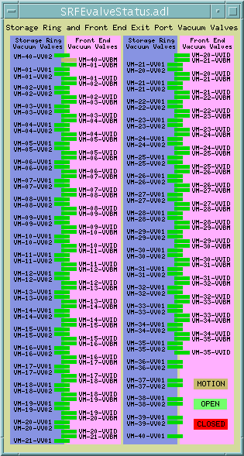
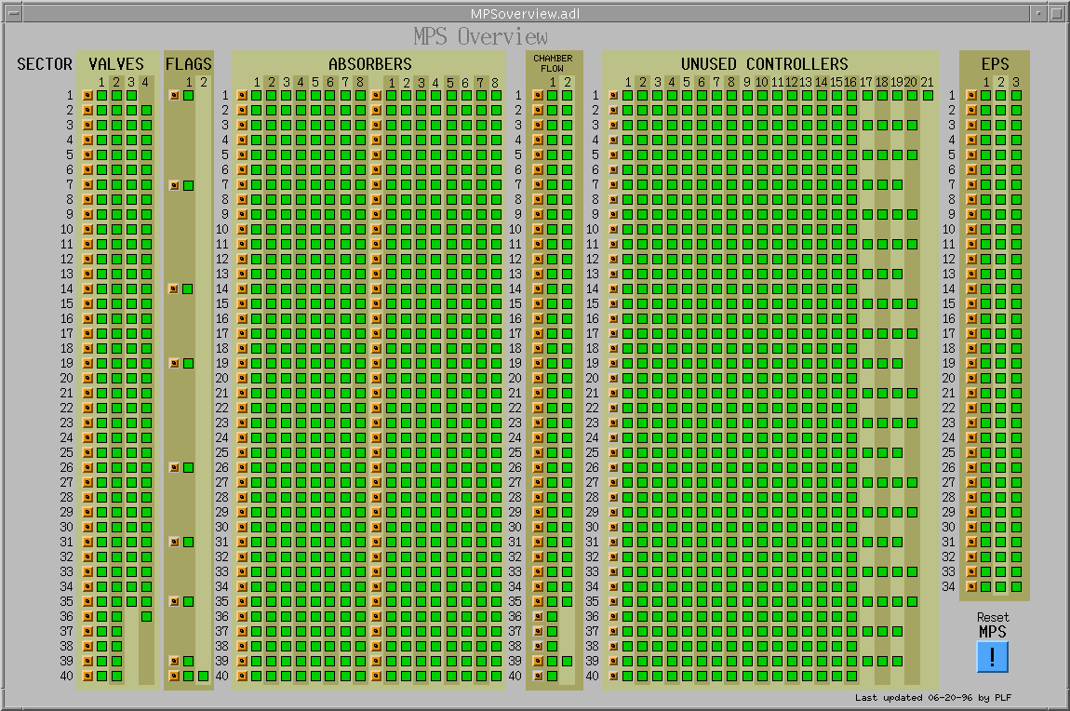
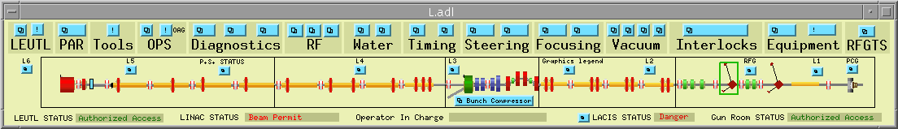
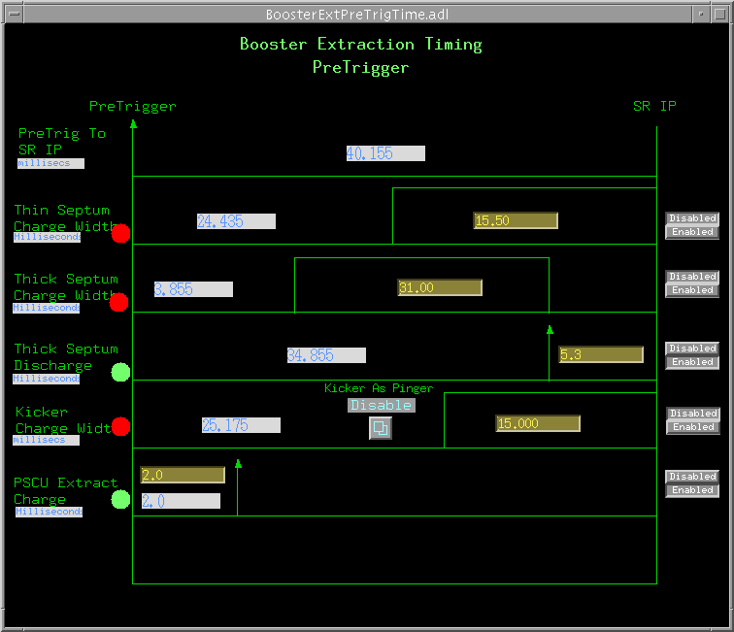
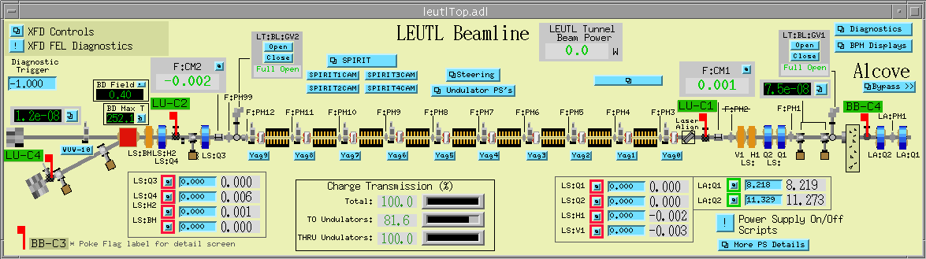
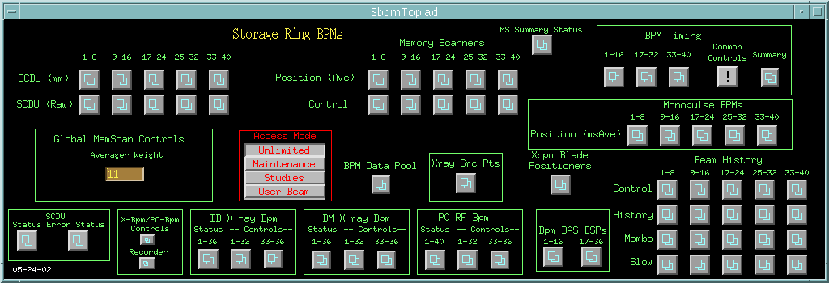
Example MEDM Screens
And thousands of others

Slide 6
History
It is an APS product
Started by Mark Anderson in 1990
  Responsible for the look and feel, much of the implementation
  Based on DM and EDD written at Los Alamos
  Choose Motif for a more impressive interface
Taken over by Fred Vong from Fall 1994 to Winter 1996
  Improved the performance under load
  Rewrote the Strip Chart
  Many of his improvements were unfinished when he left
Taken over by Ken Evans in 1996
  Concentrated on robustness, stability
  Added most of the Editing features (Undo, Align, etc.)
  Made Composite object be dynamic
  Added animated GIFs, many other features

Slide 7
MEDM Design Philosophy
Performance, robustness, and maintainability come first
  KISS [Keep It Simple Stupid] tends to work well
Features are important but feature bloat is incommensurate with robustness and maintainability
MEDM tries to strike a balance
  Robustness and maintainability come first
MEDM tries to enable, not restrict, the user
  You are responsible for not shooting yourself in the foot
Extensibility is best added with additional applications
  ADT is a good example
  As are all the Tcl/Tk apps at the APS
  If these crash or use resources, they do not affect MEDM
  MEDM can do the few things it does rapidly and efficiently
  This philosophy has worked out well at the APS

Slide 8
More Information
There is far more to MEDM than can be covered in this presentation
The main source of information is the MEDM Reference Manual
  Can be accessed from the Help Menu
    Uses your browser to display HTML help
    Netscape on UNIX may take a long time to come up
  Also available as a Word document, Postscript, and PDF
There is an MEDM web page
  http://www.aps.anl.gov/epics/extensions/medm/index.php
  Has the Reference Manual and tar files of recent versions
  Can be found from the EPICS home page
http://www.aps.anl.gov/epics/index.php
MEDM for Windows is in the EPICS WIN32 Extensions
  See the MEDM web page

Slide 9
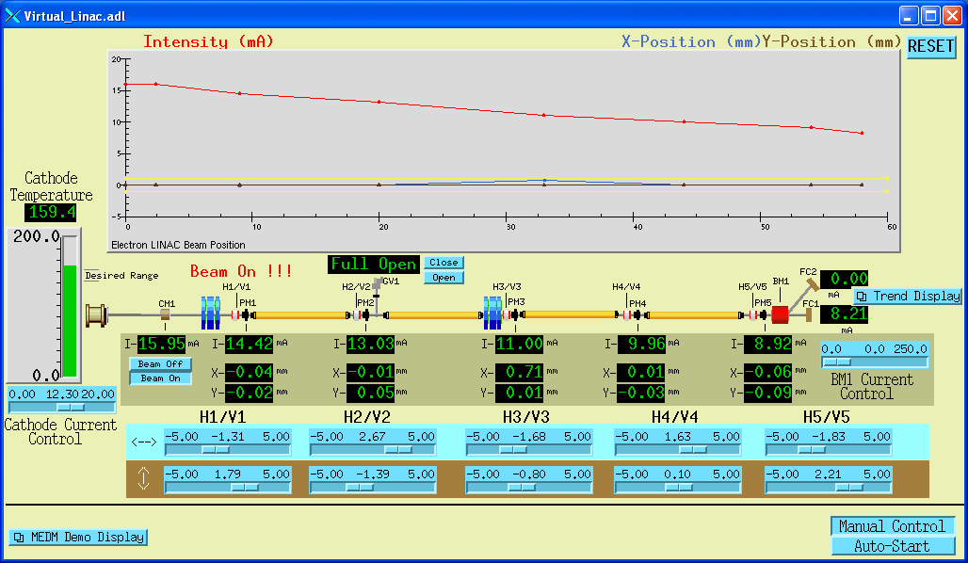
MEDM Virtual Linac Screen
The Virtual Linac MEDM screen is a good example to explore

Slide 10
Flash Demos
The demos in this presentation use Flash
If you do not see the demos, you do not have the Flash Player
If you have trouble with the Flash demos, particularly advancing them, you may have an old Flash Player
  Right click on a Flash demo to see the version
  You need Flash Player 7 or above

Slide 11
MEDM Main Window and Overview
Flash Demonstration of MEDM Main Window

Slide 12
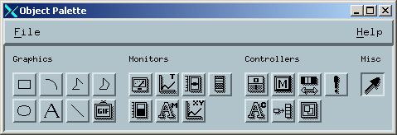
MEDM Objects
Graphics
Monitors
Controllers
Special
Arc
Bar Monitor
Choice Button
Composite
Image
Byte Monitor
Menu
Display
Line
Cartesian Plot
Message Button
Oval
Meter
Related Display
Polygon
Scale Monitor
Shell Command
Polyline
Strip Chart
Slider
Rectangle
Text Monitor
Text Entry
Text

Slide 13
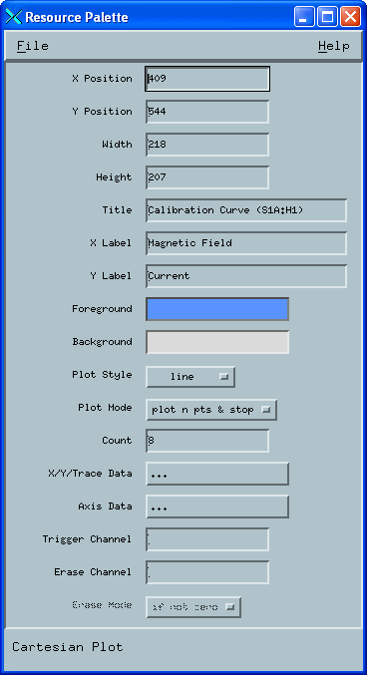
Resource Palette
Each object has a set of properties
The properties are chosen via the Resource Palette
All objects have
  X and Y Position
  Height and Width
Others vary depending on the object
Properties are specified by
  Text Boxes
  Color selectors
  Pull down menus
  Dialogs

Slide 14
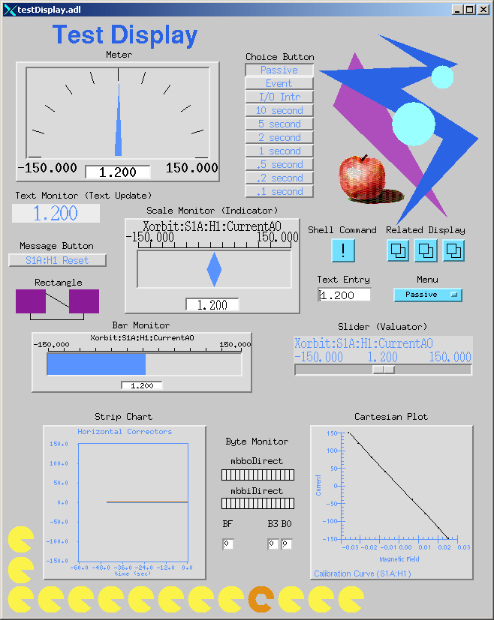
Examples of All MEDM Objects

Slide 15
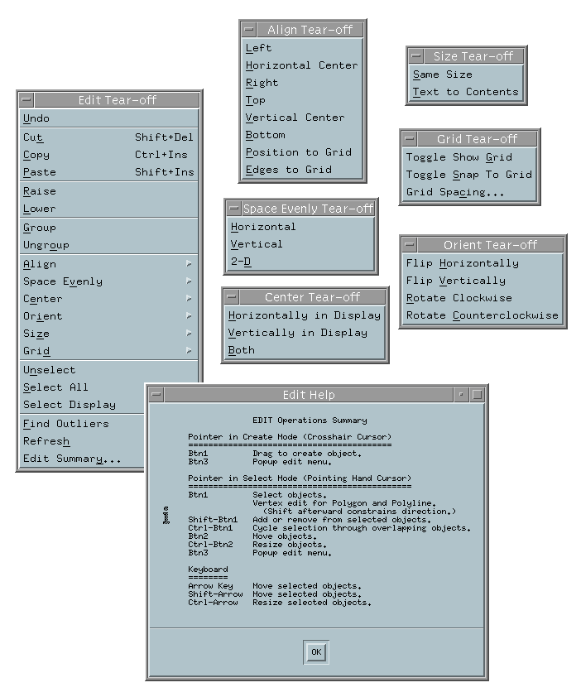
Editing Features
Menus are all Tear-Off
Undo and Redo
Align
  Left, Horizontal Center, Right
  Top, Vertical Center, Bottom
  Position to Grid
  Edges to Grid
Space Evenly
  Horizontal and Vertical
  2-D
Grid
  Toggle Show Grid
  Toggle Snap to Grid
  Set Grid Spacing

Slide 16
Editing Features
Center
  Horizontally and Vertically in Display
  Both
Orient
  Flip Horizontally and Vertically
  Rotate Clockwise and Counterclockwise
Size
  Same Size
  Text to Contents
Others
  Find Outliers
  Refresh
Edit Summary (Keyboard and Button Shortcuts)

Slide 17
Creating a Display Screen
Flash Demonstration of Display Editing

Slide 18
Fonts
Fonts in MEDM are somewhat brain dead
  Changing them would trash thousands of existing screens
MEDM can use either Fixed or Scalable fonts
Fixed fonts use font aliases for flexibility
  widgetDM_4, widgetDM_6, … ,widgetDM_60
  These can be assigned to any X Windows Font
  We are stuck with the original APS assignments
Scalar fonts use one font (your choice) and vary the size
  Was not available when the APS was started
For new sites, the defaults can be changed in siteSpecific.h
  When MEDM is built
The font size is determined by the height of the text box
  The text can extend beyond the box horizontally
  In practice you vary it until it looks right

Slide 19
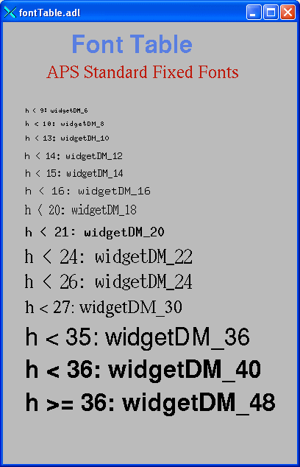
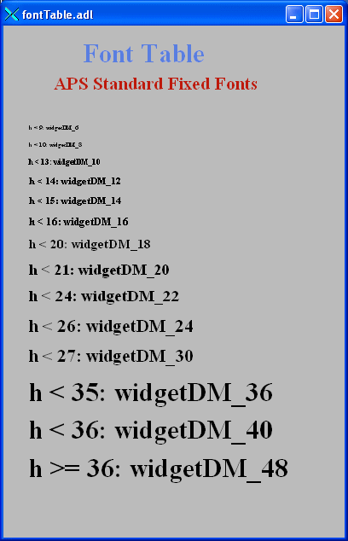
Default Fixed and Scalable Fonts
fontTable.adl opened without and with –displayFont scalable
Note:
The scalable fonts do not use widgetDM_xxx
The words are only accurate for the default fixed fonts and were determined empirically
The height (h) values do not scale uniformly
widgetDM_4 and widgetDM_60 are not possible
However, adjusting the height until it looks right works OK

Slide 20
siteSpecific.h
Many of the MEDM default choices are in siteSpecific.h
  C language header file
  Used when MEDM is compiled
Sites can change these defaults by changing this one file
Some of the things that can be changed
  Fixed or Scalable fonts
  Colors
  Location of the HTML Reference Manual
  Printer defaults
  Others
Decisions must be made early before many screens are designed

Slide 21
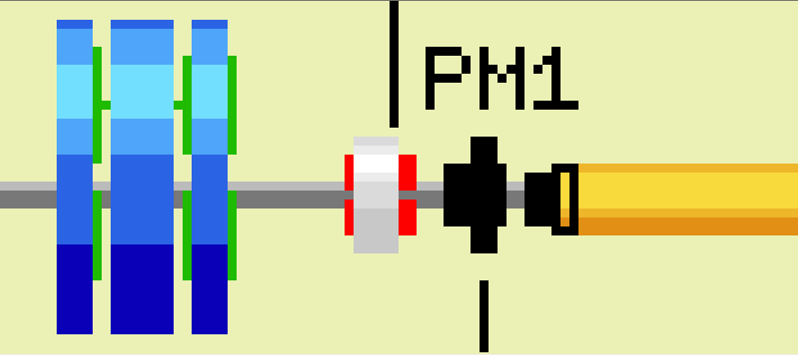
Graphic Objects
Many effects are created with Graphics objects

Slide 22
Dynamic Attribute
Applies primarily to Graphics objects
Objects with a Dynamic Attribute can have their color or visibility change based on process variables or conditions
Color Mode
  Object has alarm colors (Green, Yellow, Red, White)
Visibility Mode
  Visible only if the process variable is zero or only if not zero
Visibility Calc Mode
  Visibility is based on a CALC expression involving up to 4 process variables plus HOPR, LOPR, STAT, SEVR, etc.
Also applies to the Composite
  Allows whole sections of the display to appear or disappear
  Means any object can have a Dynamic Attribute
    Make it be a Composite with just one member

Slide 23
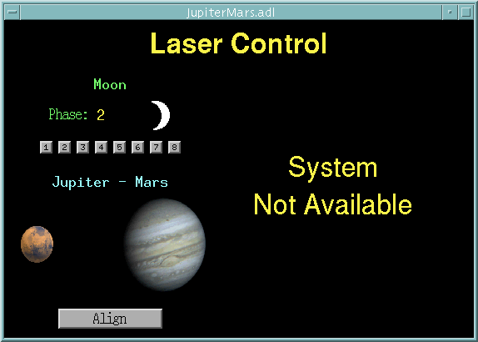
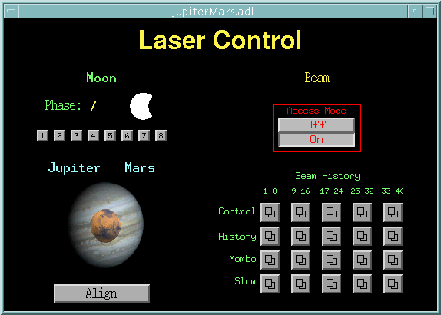
CALC in MEDM
Used in two places
Visibility
  Used when Visibility mode is set to “calc” and Visibility Calc is defined
  CALC expression returns True or False
  The APS Status Display uses this feature
    With Composites (like the Demo)
Image Frame Number (Animated GIFs)
  Used when Image Calc is defined
    Will just animate otherwise
  CALC expression returns a frame number
  Frame numbers start with 0
  Uses 0 or last frame if out of range

Slide 24
Visibility Demo
Flash Demonstration of Dynamic Attributes

Slide 25
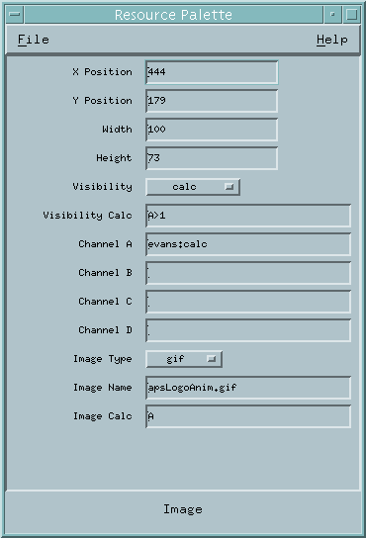
MEDM CALC Expression
Expression involving 16 variables
  A The value of Channel A
  B The value of Channel B
  C The value of Channel C
  D The value of Channel D
  E Reserved
  F Reserved
  G The COUNT of Channel A
  H The HOPR of Channel A
  I The STATUS of Channel A
  J The SEVERITY of Channel A
  K The PRECISION of Channel A
  L The LOPR of Channel A
calc
A>1
Channel A
A

Slide 26

Examples of MEDM CALC Expressions
Syntax is the same as for the EPICS CALC record
  See the Record Reference Manual
Some True/False Examples (for Visibility)
  !A Value is zero (Same as "if zero")
  A Value not zero (Same as 'if not zero")
  A=12 Value is 12
  A#12 Value is not 12
  A<0&&B<0&&C<0 All are negative
  A>.9*H Beyond 90% of upper limit
  !J SEVERITY is not zero
Some Number Examples (for Image Calc)
  A Frame is value of A
  A=12 Frame 0 or 1
  (A+B)*SIN(C) Frame determined by expression

Slide 27
Color Rules Using Animated GIFs
Make a multi-frame GIF
  One frame per desired color, One pixel per frame
Put this GIF under the object you want to have color rules
Use a CALC expression that rounds off to the frame number
Example: 3 colors: Green, Yellow, Red
  CALC: (ABS(A)<.8*H)+(ABS(A)<.9*H)
  Gives: Green for |A| up to 0.8*HOPR
Yellow for |A| from 0.8*HOPR to 0.9*HOPR
Red for |A| greater than 0.9*HOPR

Slide 28
Use SGA to Make and Edit Animated GIFs

Slide 29
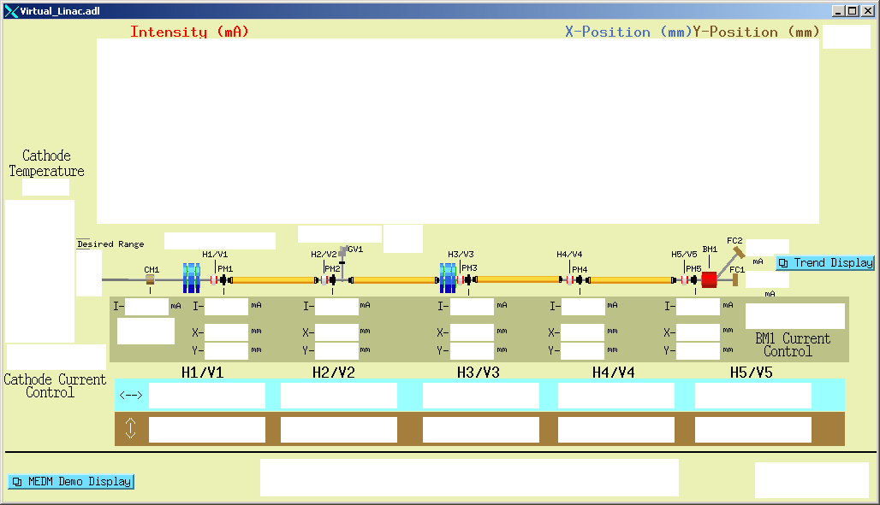
Execute Mode
What’s wrong with this screen?
MEDM objects turn white when the connection is lost

Slide 30

Drag and Drop
You can drag the process variable names from an object
  Use Mouse Button 2
The Process variable name appears in its alarm color on black
Can be dragged to any Motif Drop Site
  This includes Probe, StripTool, HistTool, and others
Names now go into the X Clipboard as well
  Can paste them in the usual places without even dragging
In practice Button 2 is used as a fast way to see the process variable name

Slide 31
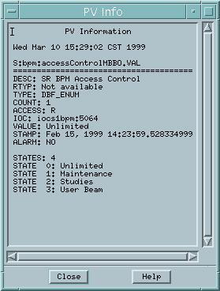
PV Info
PV Info
  Gives extensive information about the process variable
Accessed through the Execute-Mode Menu
  Right click the display
  Use the cursor to pick which object

Slide 32
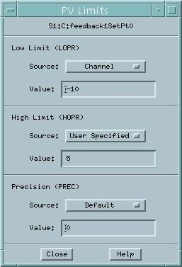
PV Limits
PV Limits
  Allows you to set the limits for Meters, Sliders, etc
The user can:
  Use the values from Channel Access (HOPR, LOPR, PREC)
  Use the defaults set by the screen designer
  Set her own values
The screen designer can:
  Set it to use Channel Access values for the defaults
  Set the defaults
Accessed through the Execute-Mode Menu

Slide 33
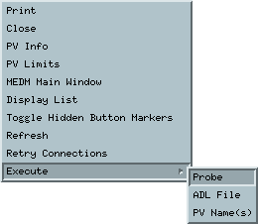
Execute Menu
The Execute Menu is a user-configurable menu that can be added to the right-click menu on displays in Execute Mode
Specified by the MEDM_EXEC_LIST environment variable
  If not specifed, it doesn’t appear at all
Example
  setenv MEDM_EXEC_LIST 'Probe;probe &P &:
ADL File;echo &A:PV Name(s);echo &P'
  Gives the menu shown
  Selecting the Probe item, for example, will allow you to select an object, then run Probe on its process variable
See the manual for details

Slide 34
Macros
Strings of the form $(name) in an ADL file can be replaced by some other string
  For example, enter $(sector):$(corrector) as part of a PV name
Replacement is specified:
  1. On command line:
medm –x –macro ”sector=S1A,corrector=H2”
  2. In Related Display configuration:
Resource Palette dialog
Allows you to design one screen and use it for many similar items
The Virtual Linac uses $(user) in front of PV names
  So different users have their own PV names
  Look at the startup scripts for MEDM for the Virtual Linac

Slide 35
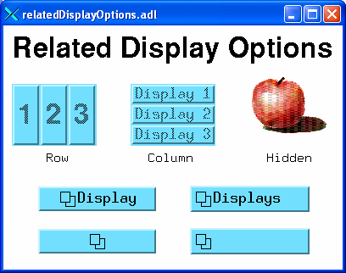
Related Display
Brings up a menu of other displays
As with most MEDM objects there are many options
If you Control-Click, then the new display replaces the current one
If there is only one item in the menu, the label is centered, and clicking it brings up that one display
If there is more than one item in the menu, the label is left justified

Slide 36
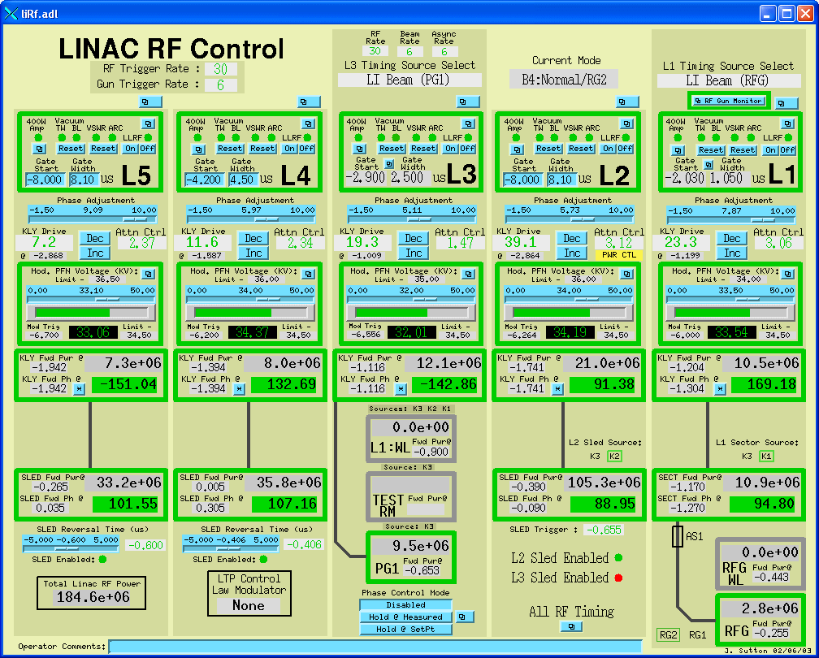

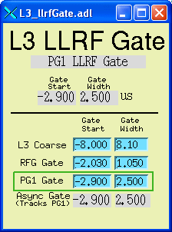
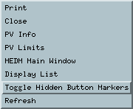
Hidden Button Markers
Related Displays can be hidden under other objects
Toggle Hidden Button Markers shows where they are
Clicking on a hidden button brings up a (single) display just like the more conventional Related Display

Slide 37
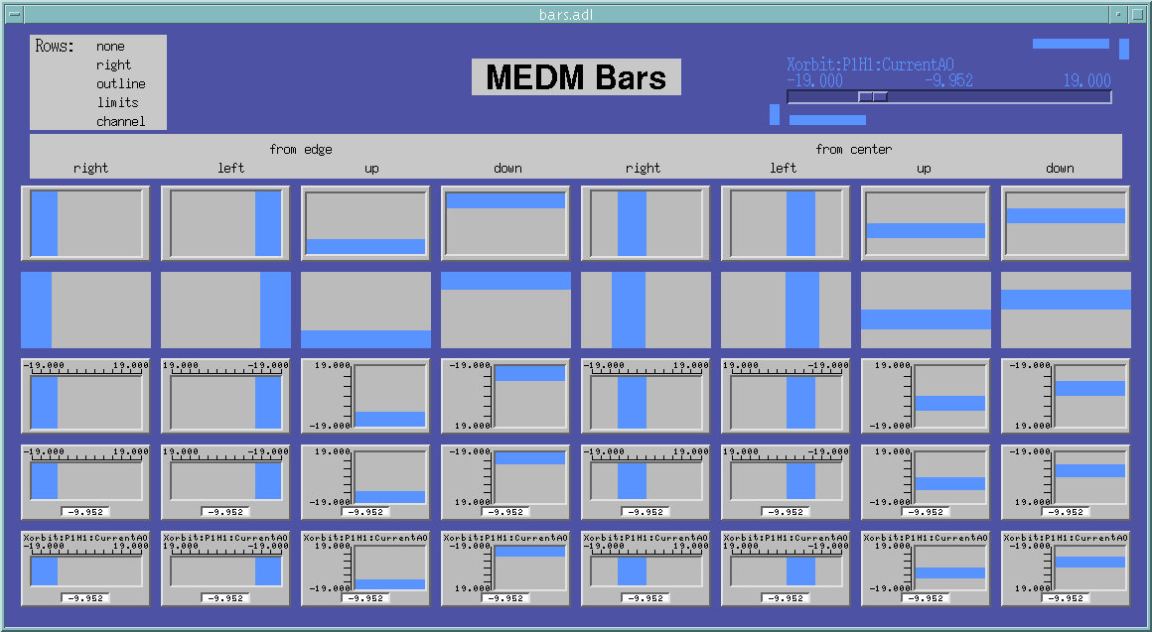
Bar Monitor
Here are some options for the Bar Monitor

Slide 38
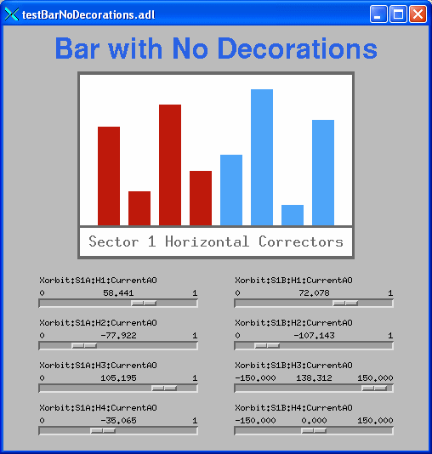
Bar Monitor
The no decorations mode, useful for bar graphs and effects

Slide 39
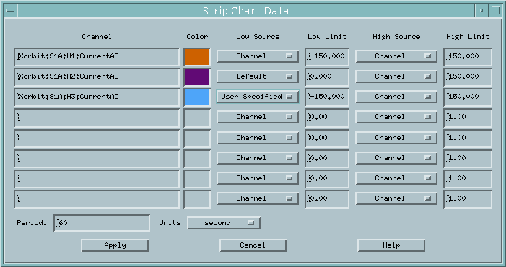
Strip Chart
While not as powerful as StripTool, the MEDM Strip Chart has many features, which can be changed on the fly
This dialog comes up via PV Limits on the Execute Mode Menu in place of the usual PV Limits dialog

Slide 40
Cartesian Plot
The Cartesian Plot is the most complicated MEDM object
MEDM provides generic support for different plot packages
XRT/Graph
  Most complete implementation is XRT/Graph
  Commercial product, not available for Windows
  Requires a license on each machine on which it is built
  Many features and works well
SciPlot
  Public Domain, modified extensively for MEDM
  Included with MEDM, should work on any platform
  Currently missing Second Y axis and Fill Under
JPT
  Developed at TJNAF
  Does not support all MEDM Cartesian Plot features

Slide 41
Summary
MEDM is a full featured, mature, robust program
It is the principal means by which humans control the system
This has been an overview of some of the MEDM features
  There are many more
  The Reference Manual is the best source of information

